Slide 1
G PULLAIAH COLLEGE OF ENGINEERING AND TECHNOLOGY
(An Autonomous Institute affiliated to JNTUA, Ananthapuram)
DEPARTMENT OF COMPUTER SCIENCE AND ENGINEERING
IoT-Powered Smart Pendant for Women’s Safety:
A Next-Gen Protective Solution
HOD
Mrs K. LAKSHMI M.Tech.,(Ph.D)
Project Guide Mr D. JAYANARAYANA REDDY M.Tech., (Ph.D.)
Project Coordinator
K MANJUSHA
M.Tech.
DARJI ABDUL MOUIZE (21AT1A0540)
APPALA RISHITH (21AT1A0503)
C SAI SURYA REDDY (21AT1A0526)
GOLLA VENKATESH (21AT1A0552)
GOLLA SAI VAMSHI (21AT1A0548)
Team Members

Slide 2
CONTENTS
Motivation
Objectives
Abstract
Introduction
Block diagram
Methodology and Proposed System
Software Used
Advantages & Disadvantages
9.Conclusion

Slide 3
Motivation
Rising safety concerns for women.
Growing need for women’s safety.
Easy-to-use and wearable solution..
Real-time assistance through IoT integration..
Empowering women with increased independence.
Affordable and practical device.

Slide 4
objectives
The objectives of this study are to design a reliable and user-friendly safety system that ensures real-time monitoring, immediate response, and enhanced communication features, thereby fostering a safer environment for women. The study employs a multi- faceted approach involving the integration of advanced sensors, GPS, and IoT connectivity into a discreet wearable device, supported by a smartphone application. Methods include system design, hardware development, software implementation, and performance testing under simulated conditions to ensure reliability and usability.

Slide 5
ABSTRACT
According to the National Crime Records Bureau (NCRB), 93.3% of victims are solitary female travelers, highlighting the persistent safety challenges women face despite advancements in societal roles. While technological solutions for women’s safety exist, gaps remain in the seamless integration of user-friendly, real-time, and responsive security systems that align with modern lifestyles. Existing solutions often lack portability, immediate response mechanisms, and the ability to integrate IoT-based monitoring tools effectively. Addressing these gaps, this study aims to develop a comprehensive Women Safety Device that combines a smartphone application and a wearable smart pendant leveraging the Internet of Things (IoT).

Slide 6
INTRODUCTION
In contemporary times, ensuring the safety and security of women has become an imperative aspect of societal progress. The Women Safety Pendant Device project is an innovative initiative aimed at leveraging technology, specifically the Internet of Things (IOT), to address the pressing concerns surrounding women's safety. This project envisions a wearable device that not only empowers women but also revolutionizes the way personal safety is approached in today's dynamic environment.
The Women Safety Pendant, enriched with IoT capabilities, is not just a wearable device; it is a holistic safety solution tailored to the modern lifestyle. By amalgamating technology, connectivity, and user-centric design, this device aims to empower women, providing them with a sense of security and confidence in their daily lives. As we navigate the future, the Women Safety Pendant stands at the forefront, exemplifying the potential of IoT to create meaningful solutions for societal challenges.

Slide 7
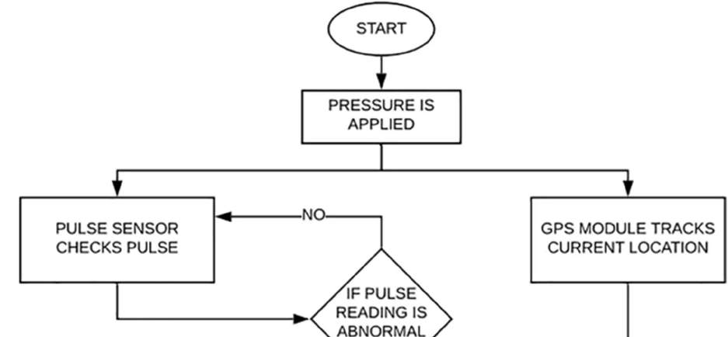
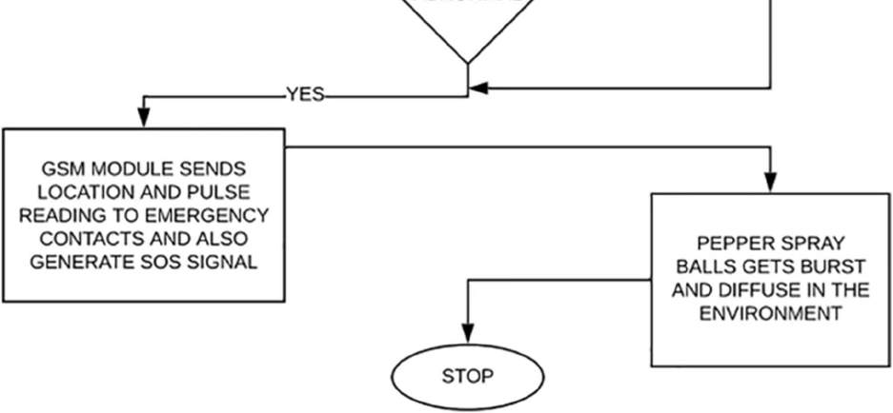
METHODOLOGY

Slide 8


SOFTWARE TOOL USED
The Arduino Integrated Development Environment (IDE) is a software platform designed for programming Arduino microcontroller boards. It provides a user-friendly interface for writing, compiling, and uploading code to Arduino-compatible devices. The IDE is open-source and supports various operating systems, including Windows, macOS, and Linux.

Slide 9
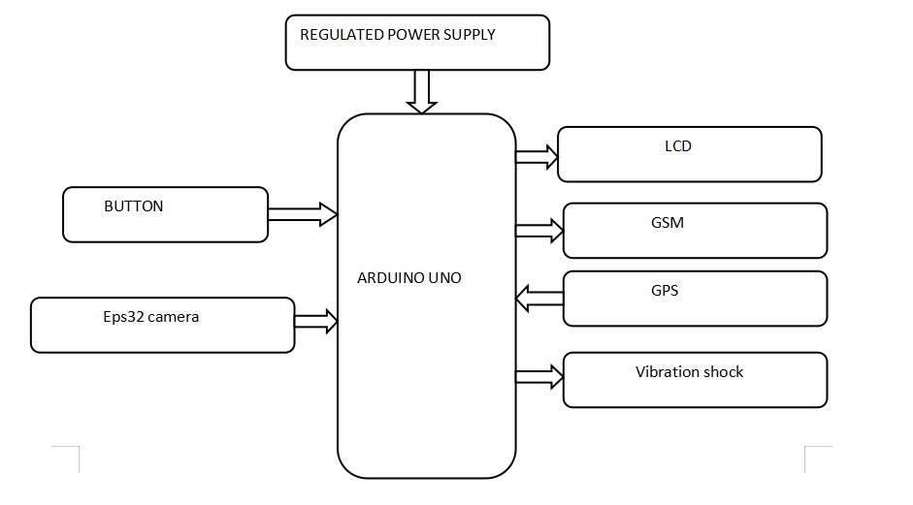
PROPOSED block diagram

Slide 10
proposed system
Our proposed system prioritizes self-defense by employing a mechanism that administers a controlled electric shock to deter perpetrators, thereby diminishing their state of agitation and facilitating the woman's escape from critical situations.
Additionally, we aim to integrate a device that operates autonomously, eliminating the need for manual intervention, thus ensuring women's safety in various public settings such as transportation vehicles (such as cabs, taxis, buses, and auto-rickshaws) and workplaces.
This device comprises an emergency button which not only tracks the user's location but also dispatches SMS alerts to parents or nearby law enforcement agencies. Within the proposed system, we have meticulously designed equipment to enhance the alerting mechanism, thereby bolstering
its effectiveness.
The GSM module facilitates the transmission of SMS messages containing GPS coordinates, while the LCD screen serves as a means of visual feedback.

Slide 11
ADVANTAGES &DISADVANTAGES
Advantages:
> Enhanced Safety: Provides a discreet and reliable way to send alerts during emergencies, improving personal safety for women.
> Real-Time Tracking: GPS-enabled tracking allows quick location sharing with trusted contacts or authorities.
> Quick Emergency Response: Features like one-touch SOS ensure rapid alerting during critical situations.
Disadvantages:
> Battery Dependency: Requires regular charging, and failure to charge could render it non-functional in emergencies.
> Cost: May be expensive for some users due to advanced IoT and GPS technology.
> False Alarms: Accidental activation of the SOS feature could cause unnecessary panic or wasted resources.

Slide 12
CONCLUSION
In conclusion, the Women Safety Pendant Device using IOT not only addresses current safety concerns but also lays the groundwork for a future where technology plays a pivotal role in creating safer and more secure environments for women.
Smart pendants leveraging IoT technology represent a significant advancement in women's safety solutions, offering a blend of innovation, convenience, and reliability to empower women to lead safer and more secure lives.
As technology advances and societal needs evolve, this project serves as a catalyst for ongoing innovation in the critical domain of women's safety

Slide 13
QUERIES?

Slide 14
THANK YOU

